Slide 1
CH05 Database Security
Zonghua Gu
2018, ZJU
Notes:
This chapter provides an overview of computer security. We begin with a discussion
of what we mean by computer security. In essence, computer security deals
with computer-related assets that are subject to a variety of threats and for which
various measures are taken to protect those assets. Accordingly, the next section of
this chapter provides a brief overview of the categories of computer-related assets
that users and system managers wish to preserve and protect, and a look at the
various threats and attacks that can be made on those assets. Then, we survey the
measures that can be taken to deal with such threats and attacks. This we do from
three different viewpoints, in Sections 1.3 through 1.5. We then lay out in general
terms a computer security strategy.
The focus of this chapter, and indeed this book, is on three fundamental
questions:
1. What assets do we need to protect?
2. How are those assets threatened?
3. What can we do to counter those threats?

Slide 2
Outline
Relational databases
SQL injection attacks
Access control
Inference
Database encryption
Notes:
Cloud computing
Cloud computing elements
Cloud service models
Cloud deployment models
Cloud computing reference architecture
Cloud security approaches
Risks and countermeasures
Data protection in the cloud
Security approaches for cloud computing assets
Cloud security as a service
Open-source cloud security module
Cloud security concepts
Security issues for cloud computing
Addressing cloud computing security concerns

Slide 3
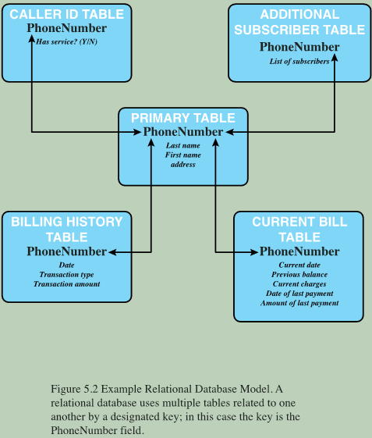
Relational Database
A relational database consists of tables
A table is defined by a schema and consists of tuples
Each tuple (row) stores attribute values as define by schema
Typically, one column contains the primary key, each uniquely identifies a tuple
Enables the creation of multiple tables linked together by keys
Structured Query Language (SQL)
Provides a uniform interface to the database
Notes:
The basic building block of a relational database is a table of data, consisting of rows
and columns, similar to a spreadsheet. Each column holds a particular type of data,
while each row contains a specific value for each column. Ideally, the table has at
least one column in which each value is unique, thus serving as an identifier for a
given entry. For example, a typical telephone directory contains one entry for each
subscriber, with columns for name, telephone number, and address. Such a table is
called a flat file because it is a single two-dimensional (rows and columns) file. In a
flat file, all of the data are stored in a single table. For the telephone directory, there
might be a number of subscribers with the same name, but the telephone numbers
should be unique, so that the telephone number serves as a unique identifier for a
row. However, two or more people sharing the same phone number might each be
listed in the directory. To continue to hold all of the data for the telephone directory
in a single table and to provide for a unique identifier for each row, we could require
a separate column for secondary subscriber, tertiary subscriber, and so on. The result
would be that for each telephone number in use, there is a single entry in the table.
The drawback of using a single table is that some of the column positions for
a given row may be blank (not used). Also, any time a new service or new type of
information is incorporated in the database, more columns must be added and the
database and accompanying software must be redesigned and rebuilt.
The relational database structure enables the creation of multiple tables
tied together by a unique identifier that is present in all tables.
Users and applications use a relational query language to access the database.
The query language uses declarative statements rather than the procedural
instructions of a programming language. In essence, the query language allows
the user to request selected items of data from all records that fit a given set of
criteria. The software then figures out how to extract the requested data from one
or more tables. For example, a telephone company representative could retrieve a
subscriber’s billing information as well as the status of special services or the latest
payment received, all displayed on one screen.

Slide 4

Relational Database Elements
Primary key
Uniquely identifies a row
Consists of one or more column names
Foreign key
Links one table to attributes in another table
View/virtual table
Result of a query that returns selected rows and columns from one or more tables
Notes:
In relational database parlance, the basic building block is a relation , which is a
flat table. Rows are referred to as tuples , and columns are referred to as attributes
A primary key is defined to be a portion of a row used to uniquely
identify a row in a table; the primary key consists of one or more column names.
In the example of Figure 5.2 , a single attribute, PhoneNumber, is sufficient to
uniquely identify a row in a particular table.
To create a relationship between two tables, the attributes that define the
primary key in one table must appear as attributes in another table, where they are
referred to as a foreign key . Whereas the value of a primary key must be unique
for each tuple (row) of its table, a foreign key value can appear multiple times in
a table, so that there is a one-to-many relationship between a row in the table with
the primary key and rows in the table with the foreign key.
A view is a virtual table. In essence, a view is the result of a query that returns
selected rows and columns from one or more tables.
Views are often used for security purposes. A view can provide restricted access to a
relational database so that a user or application only has access to certain rows or columns.

Slide 6
Notes:
Figure 5.4a provides an
example. In the Department table, the department ID (Did ) is the primary key;
each value is unique. This table gives the ID, name, and account number for each
department. The Employee table contains the name, salary code, employee ID, and
phone number of each employee. The Employee table also indicates the department
to which each employee is assigned by including Did . Did is identified as a foreign key
and provides the relationship between the Employee table and the Department table.
Figure 5.4b is a view that
includes the employee name, ID, and phone number from the Employee table and
the corresponding department name from the Department table. The linkage is the
Did , so that the view table includes data from each row of the Employee table, with
additional data from the Department table. It is also possible to construct a view
from a single table. For example, one view of the Employee table consists of all
rows, with the salary code column deleted. A view can be qualified to include only
some rows and/or some columns. For example, a view can be defined consisting of
all rows in the Employee table for which the Did = 15.

Slide 7
Structured Query Language (SQL)
Standardized language to define schema, manipulate, and query data in a relational database.
Operations include:
Create tables
Insert and delete data in tables
Create views
Retrieve data with query statements
Example: SELECT * FROM EMLPOYEE WHERE DID=‘15’
return all tuples in EMPLOYEE table with attribute DID=‘15’
Notes:
Structured Query Language (SQL) is a standardized language that can be used to
define schema, manipulate, and query data in a relational database. There are several
versions of the ANSI/ISO standard and a variety of different implementations,
but all follow the same basic syntax and semantics.
SQL statements
can be used to create tables, insert and delete data in tables, create views, and
retrieve data with query statements.
create, select, insert, update, join, delete…

Slide 8
OS vs. Database Security
OS security mechanisms typically control read and write access to entire files, but not to limit access to specific records or fields in that file.
A database typically allows this type of fine-grained access control, expressed with SQL commands, such as to select, insert, update, or delete specified items in the database.
Thus, security services and mechanisms are needed that are designed specifically for database systems.

Slide 9
Outline
Relational databases
SQL injection attacks
Access control
Inference
Database encryption
Notes:
Cloud computing
Cloud computing elements
Cloud service models
Cloud deployment models
Cloud computing reference architecture
Cloud security approaches
Risks and countermeasures
Data protection in the cloud
Security approaches for cloud computing assets
Cloud security as a service
Open-source cloud security module
Cloud security concepts
Security issues for cloud computing
Addressing cloud computing security concerns

Slide 10
SQL Injection Attacks (SQLi)
Sends malicious SQL commands to the database
One of the most prevalent and dangerous network-based security threats
Designed to exploit the nature of Web application pages
Can be used to
Modify or delete data
Execute arbitrary OS commands
Launch DoS attacks
Notes:
The SQL injection (SQLi) attack is one of the most prevalent and dangerous
network-based security threats. Consider the following reports:
1. The July 2013 Imperva Web Application Attack Report [IMPE13] surveyed a
cross-section of Web application servers in industry and monitored eight different
types of common attacks. The report found that SQLi attacks ranked
first or second in total number of attack incidents, the number of attack
requests per attack incident, and average number of days per month that an
application experienced at least one attack incident. Imperva observed a single
Web site that received 94,057 SQL injection attack requests in one day.
2. The Open Web Application Security Project’s 2013 report [OWAS13] on the
ten most critical Web application security risks listed injection attacks, especially
SQLi attacks, as the top risk. This ranking is unchanged from its 2010 report.
3. The Veracode 2013 State of Software Security Report [VERA13] found that
percentage of applications affected by SQLi attacks is around 32% and that
SQLi attacks account for 26% of all reported breaches. Veracode also considers
this among the most dangerous threats, reporting that three of the biggest
SQL injection attacks in 2012 resulted in millions of email addresses, user
names, and passwords being exposed and damaged the respective brands.
4. The Trustwave 2013 Global Security Report [TRUS13] lists SQLi attacks as
one of the top two intrusion techniques. The report notes that poor coding
practices have allowed the SQL injection attack vector to remain on the threat
landscape for more than 15 years, but that proper programming and security
measures can prevent these attacks.
In general terms, an SQLi attack is designed to exploit the nature of Web application
pages. In contrast to the static Web pages of years gone by, most current Web sites
have dynamic components and content. Many such pages ask for information, such
as location, personal identity information, and credit card information. This dynamic
content is usually transferred to and from back-end databases that contain volumes of
information—anything from cardholder data to which type of running shoes is most
purchased. An application server Web page will make SQL queries to databases to
send and receive information critical to making a positive user experience.
In such an environment, an SQLi attack is designed to send malicious SQL
commands to the database server. The most common attack goal is bulk extraction
of data. Attackers can dump database tables with hundreds of thousands of customer
records. Depending on the environment, SQL injection can also be exploited
to modify or delete data, execute arbitrary operating system commands, or launch
denial-of-service (DoS) attacks.

Slide 11
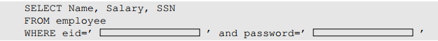
SQLi Example
The following web form’s intention is to let the user provide some data for the blank areas:
Notes:
To understand possible attacks, we consider the abstract version of the web app creates a SQL statement template and a user needs to fill in the blanks inside the rectangle area.
The attack demonstrated shows the user taking help of some special characters to change the meaning of the SQL statement.
Everything provided by user will become part of the SQL statement. Is it possible for a user to change the meaning of the SQL statement?

Slide 12
One Attack
User inputs a random string in the password entry, and EID5002’# in the eid entry.
Since everything from the # sign to the end of line is considered as comment, the SQL statement will be equivalent to the right statement, with no password checking
SELECT Name, Salary, SSN
FROM employee
WHERE eid=‘EID5002’ #’ and password=‘xyz’
SELECT Name, Salary, SSN
FROM employee
WHERE eid=‘EID5002’

Slide 13
More Attacks
Left: user enters a’ OR 1=1 to create a predicate for WHERE clause, which is always true, so it returns all the records from the database, even if he does not know all the eid’s in the database.
Right: user enters a’; DROP table employee. The database views this SQL statement as 2 separate statements separated by ;
First select all entries with eid=‘a’, then delete the entire employee table.
As countermeasure, use mysql_real_escape_string() to prepend backslashes to some special characters, including \n, \r, \, ‘, “. Now we have: WHERE name = ‘a\‘\; drop table suppliers’. The database looks for a tuple with name matching the long string a’; drop table employee, and returns null.
SELECT Name, Salary, SSN
FROM employee
WHERE eid=‘a’ OR 1=1
SELECT Name, Salary, SSN
FROM employee
WHERE eid=‘a’; DROP table employee

Slide 14
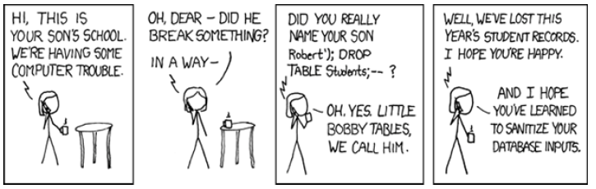
SQLi Cartoon

Slide 15
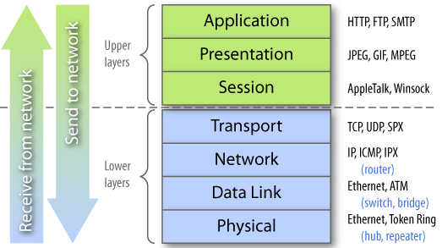
SQLi is Application-Level Attack
Not detectable by lower-layer defense mechanisms such as firewalls

Slide 16
SQLi Countermeasures
Defensive coding
Parameterized query insertion
SQL DOM
Detection
Signature based
Anomaly based
Code analysis
Run-time prevention
Check queries at runtime to see if they conform to a model of expected queries
Notes:
Because SQLi attacks are so prevalent, damaging, and varied both by attack avenue and
type, a single countermeasure is insufficient. Rather an integrated set of techniques
is necessary. In this section, we provide a brief overview of the types of countermeasures
that are in use or being researched, using the classification in [SHAR13].
These countermeasures can be classified into three types: defensive coding, detection,
and run-time prevention.
Many SQLi attacks succeed because developers have used insecure coding
practices. Thus, defensive coding is an effective way to dramatically reduce the
threat from SQLi. Examples of defensive coding include the following:
• Manual defensive coding practices: A common vulnerability exploited by
SQLi attacks is insufficient input validation. The straightforward solution for
eliminating these vulnerabilities is to apply suitable defensive coding practices.
An example is input type checking, to check that inputs that are supposed to
be numeric contain no characters other than digits. This type of technique
can avoid attacks based on forcing errors in the database management system.
Another type of coding practice is one that performs pattern matching to try
to distinguish normal input from abnormal input.
• Parameterized query insertion: This approach attempts to prevent SQLi by
allowing the application developer to more accurately specify the structure
of an SQL query, and pass the value parameters to it separately such that any
unsanitary user input is not allowed to modify the query structure.
• SQL DOM: SQL DOM is a set of classes that enables automated data type
validation and escaping [MCCL05]. This approach uses encapsulation of
database queries to provide a safe and reliable way to access databases. This
changes the query-building process from an unregulated one that uses string
concatenation to a systematic one that uses a type-checked API. Within the
API, developers are able to systematically apply coding best practices such as
input filtering and rigorous type checking of user input.
A variety of detection methods have been developed, including the following:
• Signature based: This technique attempts to match specific attack patterns.
Such an approach must be constantly updated and may not work against self-modifying
attacks.
• Anomaly based: This approach attempts to define normal behavior and then
detect behavior patterns outside the normal range. A number of approaches
have been used. In general terms, there is a training phase, in which the system
learns the range of normal behavior, followed by the actual detection phase.
• Code analysis: Code analysis techniques involve the use of a test suite to
detect SQLi vulnerabilities. The test suite is designed to generate a wide range
of SQLi attacks and assess the response of the system.
Finally, a number of run-time prevention techniques have been developed as
SQLi countermeasures. These techniques check queries at runtime to see if they
conform to a model of expected queries. Various automated tools are available for
this purpose [CHAN12, SHAR13].

Slide 17
Outline
Relational databases
SQL injection attacks
Access control
Inference
Database encryption
Notes:
Cloud computing
Cloud computing elements
Cloud service models
Cloud deployment models
Cloud computing reference architecture
Cloud security approaches
Risks and countermeasures
Data protection in the cloud
Security approaches for cloud computing assets
Cloud security as a service
Open-source cloud security module
Cloud security concepts
Security issues for cloud computing
Addressing cloud computing security concerns

Slide 18
Database Access Control
Access control determines:
If the user has access to the entire database or just portions of it
What access rights the user has (create, insert, delete, update, read, write)
Can support a range of administrative policies:
Centralized administration
Small number of privileged users may grant and revoke access rights
Ownership-based administration
The creator of a table may grant and revoke access rights to the table
Decentralized administration
The owner of the table may grant and revoke authorization rights to other users, allowing them to grant and revoke access rights to the table
Notes:
Commercial and open-source DBMSs typically provide an access control capability
for the database. The DBMS operates on the assumption that the computer system
has authenticated each user. As an additional line of defense, the computer system
may use the overall access control system described in Chapter 4 to determine
whether a user may have access to the database as a whole. For users who are
authenticated and granted access to the database, a database access control system
provides a specific capability that controls access to portions of the database.
Commercial and open-source DBMSs provide discretionary or role-based
access control. We defer a discussion of mandatory access control considerations
to Chapter 13 . Typically, a DBMS can support a range of administrative policies,
including the following:
• Centralized administration: A small number of privileged users may grant and
revoke access rights.
• Ownership-based administration: The owner (creator) of a table may grant
and revoke access rights to the table.
• Decentralized administration: In addition to granting and revoking access rights
to a table, the owner of the table may grant and revoke authorization rights to
other users, allowing them to grant and revoke access rights to the table.
As with any access control system, a database access control system distinguishes
different access rights, including create, insert, delete, update, read, and write. Some
DBMSs provide considerable control over the granularity of access rights. Access
rights can be to the entire database, to individual tables, or to selected rows or columns
within a table. Access rights can be determined based on the contents of a table entry.
For example, in a personnel database, some users may be limited to seeing salary
information only up to a certain maximum value. And a department manager may
only be allowed to view salary information for employees in his or her department.

Slide 19
SQL Access Controls
Two commands for managing access rights:
GRANT and REVOKE
Typical access rights are:
Select
Insert
Update
Delete
References
Examples:
GRANT SELECT on ANY TABLE to Alice
It enables user Alice to query any table in the database; but Alice cannot further propagate the access to other users, due to lack of “WITH GRANT OPTION” (similar to * in Access Control Matrix in CH04)
REVOKE SELECT on ANY TABLE from Alice
Revokes the SELECT right from Alice
（This is Discretionary Access Control）
GRANT { privileges | role }
[ON table]
TO { user | role | PUBLIC }
[IDENTIFIED BY password]
[WITH GRANT OPTION]
REVOKE { privileges | role }
[ON table]
FROM { user | role | PUBLIC }
Notes:
SQL provides two commands for managing access rights, GRANT and REVOKE.
For different versions of SQL, the syntax is slightly different. In general terms, the
GRANT command has the following syntax:
GRANT { privileges | role }
[ON table]
TO { user | role | PUBLIC }
[IDENTIFIED BY password]
[WITH GRANT OPTION]
This command can be used to grant one or more access rights or can be used
to assign a user to a role. For access rights, the command can optionally specify that
it applies only to a specified table. The TO clause specifies the user or role to which
the rights are granted. A PUBLIC value indicates that any user has the specified
access rights. The optional IDENTIFIED BY clause specifies a password that
must be used to revoke the access rights of this GRANT command. The GRANT
OPTION indicates that the grantee can grant this access right to other users, with or
without the grant option.
As a simple example, consider the following statement.
GRANT SELECT ON ANY TABLE TO ricflair
This statement enables user ricflair to query any table in the database.
Different implementations of SQL provide different ranges of access rights.
The following is a typical list:
• Select: Grantee may read entire database; individual tables; or specific
columns in a table.
• Insert: Grantee may insert rows in a table; or insert rows with values for specific
columns in a table.
• Update: Semantics is similar to INSERT.
• Delete: Grantee may delete rows from a table.
• References: Grantee is allowed to define foreign keys in another table that
refer to the specified columns.
The REVOKE command has the following syntax:
REVOKE { privileges | role }
[ON table]
FROM { user | role | PUBLIC }
Thus, the following statement revokes the access rights of the preceding example:
REVOKE SELECT ON ANY TABLE FROM ricflair

Slide 20
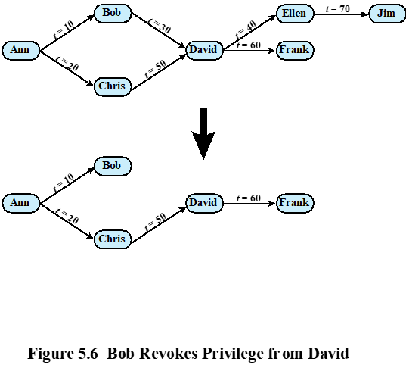
Cascaded Grants

Slide 21
Cascaded Grants Explanations
The revocation of privileges is cascaded: when user A revokes an access right, any cascaded access right is also revoked, unless that access right would exist even if the original grant from A had never occurred, i.e., it does not depend on the original grant from A.
The figure indicates that Ann grants the access right to Bob at time t = 10 and to Chris at time t = 20. Assume that the grant option is always used. Thus, Bob is able to grant the access right to David at t = 30. Chris redundantly grants the access right to David at t = 50. Meanwhile, David grants the right to Ellen, who in turn grants it to Jim; and subsequently David grants the right to Frank.
if Ann revokes the access right to Bob and Chris, then the access right is also revoked to David, Ellen, Jim, and Frank.
A complication arises when a user (David) receives the same access right multiple times.
If the grant from Bob to David at t=30 is revoked, the grants from David to Ellen at time t=40, and from Ellen to Jim at t=70, are also revoked, since they depend on the grant from Bob to David at t=30.
But the grant from David to Frank at t=60 remains, since it depends on the grant from Chris to David at t=50.
Notes:
The grant option enables an access right to cascade through a number of users.We
consider a specific access right and illustrate the cascade phenomenon in Figure 5.4 .
The figure indicates that Ann grants the access right to Bob at time t = 10 and to
Chris at time t = 20. Assume that the grant option is always used. Thus, Bob is able
to grant the access right to David at t = 30. Chris redundantly grants the access right
to David at t = 50. Meanwhile, David grants the right to Ellen, who in turn grants it
to Jim; and subsequently David grants the right to Frank.
Just as the granting of privileges cascades from one user to another using
the grant option, the revocation of privileges also cascaded. Thus, if Ann
revokes the access right to Bob and Chris, then the access right is also revoked
to David, Ellen, Jim, and Frank. A complication arises when a user receives the
same access right multiple times, as happens in the case of David. Suppose that
Bob revokes the privilege from David. David still has the access right because
it was granted by Chris at t = 50. However, David granted the access right to
Ellen after receiving the right, with grant option, from Bob but prior to receiving
it from Chris. Most implementations dictate that in this circumstance, the access
right to Ellen and therefore Jim is revoked when Bob revokes the access right
to David. This is because at t = 40, when David granted the access right to
Ellen, David only had the grant option to do this from Bob. When Bob revokes
the right, this causes all subsequent cascaded grants that are traceable solely
to Bob via David to be revoked. Because David granted the access right
to Frank after David was granted the access right with grant option from Chris,
the access right to Frank remains. These effects are shown in the lower portion of
Figure 5.6 .
To generalize, the convention followed by most implementations is as follows.
When user A revokes an access right, any cascaded access right is also revoked,
unless that access right would exist even if the original grant from A had never
occurred. This convention was first proposed in [GRIF76].

Slide 22
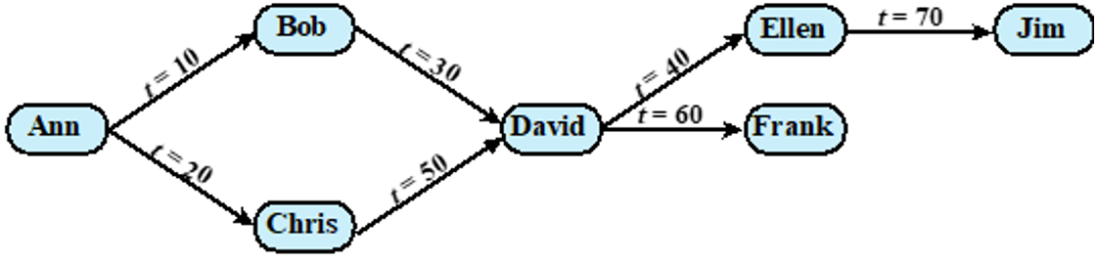
Cascaded Grants Quiz
Q: If the grant from Chris to David at t=50 is revoked, what happens to downstream grants?
ANS: None of the downstream grants will be revoked, since they depend on the grant from Bob to David at t=30, not the grant from Chris to David at t=50
Q: If the grant from Ann to Chris at t=20 is revoked, what happens to downstream grants?
ANS: The grant from Chris to David at t=50 will be revoked; all other grants remain
Q: If the grant from Ann to Bob at t=10 is revoked, what happens to downstream grants?
ANS: The grant from Bob to David, from David to Ellen, and from Ellen to Jim will be revoked; all other grants remain

Slide 23
Role-Based Access Control (RBAC)
RBAC is a natural fit for database access control.
A database system supports multiple of applications. An individual user may use a variety of applications to perform a variety of tasks, each of which requires its own set of privileges
RBAC eases administrative burden and improves security
A database RBAC needs to provide the following capabilities:
Create and delete roles
Define permissions for a role
Assign and cancel assignment of users to roles
Notes:
Categories of database users:
Application owner
An end user who owns database objects as part of an application
End user
An end user who operates on database objects via a particular application but does not own any of the database objects
Administrator
User who has administrative responsibility for part or all of the database
A role-based access control (RBAC) scheme is a natural fit for database access
control. Unlike a file system associated with a single or a few applications, a
database system often supports dozens of applications. In such an environment,
an individual user may use a variety of applications to perform a variety of tasks,
each of which requires its own set of privileges. It would be poor administrative
practice to simply grant users all of the access rights they require for all the tasks
they perform. RBAC provides a means of easing the administrative burden and
improving security.
In a discretionary access control environment, we can classify database users
in three broad categories:
• Application owner: An end user who owns database objects (tables, columns,
rows) as part of an application. That is, the database objects are generated by
the application or are prepared for use by the application.
End user other than application owner: An end user who operates on database
objects via a particular application but does not own any of the database objects.
• Administrator: User who has administrative responsibility for part or all of the
database.
We can make some general statements about RBAC concerning these
three types of users. An application has associated with it a number of tasks,
with each task requiring specific access rights to portions of the database.
For each task, one or more roles can be defined that specify the needed access
rights. The application owner may assign roles to end users. Administrators are
responsible for more sensitive or general roles, including those having to do
with managing physical and logical database components, such as data files,
users, and security mechanisms. The system needs to be set up to give certain
administrators certain privileges. Administrators in turn can assign users to
administrative-related roles.
A database RBAC facility needs to provide the following capabilities:
• Create and delete roles.
• Define permissions for a role.
• Assign and cancel assignment of users to roles.

Slide 24
Table 5.2 Fixed Roles in Microsoft SQL Server

Slide 25
Outline
Relational databases
SQL injection attacks
Access control
Inference
Database encryption
Notes:
Cloud computing
Cloud computing elements
Cloud service models
Cloud deployment models
Cloud computing reference architecture
Cloud security approaches
Risks and countermeasures
Data protection in the cloud
Security approaches for cloud computing assets
Cloud security as a service
Open-source cloud security module
Cloud security concepts
Security issues for cloud computing
Addressing cloud computing security concerns

Slide 26
Inference: performing authorized queries and deducing unauthorized information from the legitimate responses
received.
Notes:
Inference, as it relates to database security, is the process of performing authorized
queries and deducing unauthorized information from the legitimate responses
received. The inference problem arises when the combination of a number of
data items is more sensitive than the individual items, or when a combination of
data items can be used to infer data of a higher sensitivity. Figure 5.7 illustrates
the process. The attacker may make use of nonsensitive data as well as metadata.
Metadata refers to knowledge about correlations or dependencies among data
items that can be used to deduce information not otherwise available to a
particular user. The information transfer path by which unauthorized data is
obtained is referred to as an inference channel .

Slide 27
Inference Attack Examples
Consider a database of student grades with schema (StudentID, Standing (junior or senior), Exam Score). Attacker wants to find exam score of some student. Any student should be able to query for the average exam score
Example 1:
The target student Alice takes the exam late
Attacker queries for the average scores before and after Alice takes the exam, then calculate Alice’s score
Example 2:
Only one student Bob has junior standing in a class full of seniors
Attacker queries for the average score of all students with junior standing, which is equal to Bob’s score.

Slide 28
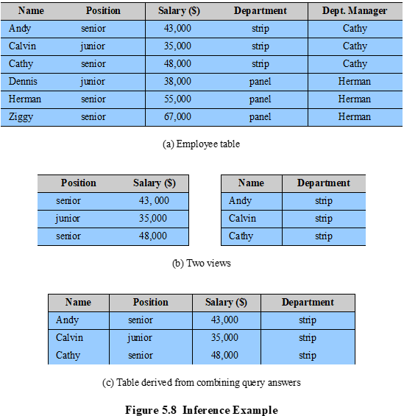
Inference Attack Examples cont’d
Each employee’s salary should be confidential
RBAC constraint: Name and Salary cannot be accessed together in the same query by the Clerk role.
But a user who knows (1) the structure of the Employee table and (2) the views maintain the same row order as the Employee table is able to merge the two views in (b) to construct the table shown in (c)
Notes:
In general terms, two inference techniques can be used to derive additional
information: analyzing functional dependencies between attributes within a table
or across tables, and merging views with the same constraints.
An example of the latter shown in Figure 5.8 , illustrates
the inference problem.
Users of these views are not authorized to access the relationship between
Name and Salary. A user who has access to either or both views cannot infer
the relationship by functional dependencies. That is, there is not a functional
relationship between Name and Salary such that knowing Name and perhaps other
information is sufficient to deduce Salary. However, suppose the two views
are created with the access constraint that Name and Salary cannot be accessed
together. A user who knows the structure of the Employee table and who knows
that the view tables maintain the same row order as the Employee table is then
able to merge the two views to construct the table shown in Figure 5.8c. This
violates the access control policy that the relationship of attributes Name and
Salary must not be disclosed.

Slide 29
Solution
Construct three tables, which include the following information:
Employee (Emp#, Name, Address)
Salary (S#, Salary)
Emp-Salary (Emp#, S#)
Each line consists of the table name followed by a list of column names for that table. In this case, each employee is assigned a unique employee number (Emp#) and a unique salary number (S#). The Employee and Salary tables are accessible to the Clerk role, but the Emp-Salary table is only available to the Administrator role. In this structure, the sensitive relationship between employees and salaries is protected from users assigned the Clerk role.
Another inference channel: suppose that we want to add a new attribute, employee start date, which is not sensitive. This could be added to the Salaries table as follows:
Employees (Emp#, Name, Address)
Salaries (S#, Salary, Start-Date)
Emp-Salary (Emp#, S#)
However, an employee’s start date is an easily observable or discoverable attribute (e.g. through human/personal connections). Thus a user in the Clerk role may be able to infer the employee’s name. This would compromise the relationship between employee and salary.
A straightforward way to remove the inference channel is to add the start-date column to the Employees table instead of the Salaries table.
Notes:
Consider a database containing personnel information,
including names, addresses, and salaries of employees. Individually, the name,
address, and salary information is available to a subordinate role, such as
Clerk, but the association of names and salaries is restricted to a superior role,
such as Administrator. This is similar to the problem illustrated in Figure 5.8.
One solution to this problem is to construct three tables, which include the
following information:
Employees (Emp#, Name, Address)
Salaries (S#, Salary)
Emp-Salary (Emp#, S#)
where each line consists of the table name followed by a list of column names for that
table. In this case, each employee is assigned a unique employee number (Emp#)
and a unique salary number (S#). The Employees table and the Salaries table
are accessible to the Clerk role, but the Emp-Salary table is only available to the
Administrator role. In this structure, the sensitive relationship between employees
and salaries is protected from users assigned the Clerk role. Now suppose that we
want to add a new attribute, employee start date, which is not sensitive. This could
be added to the Salaries table as follows:
Employees (Emp#, Name, Address)
Salaries (S#, Salary, Start-Date)
Emp-Salary (Emp#, S#)
However, an employee’s start date is an easily observable or discoverable
attribute of an employee. Thus a user in the Clerk role should be able to infer (or
partially infer) the employee’s name. This would compromise the relationship between
employee and salary. A straightforward way to remove the inference channel is to
add the start-date column to the Employees table rather than to the Salaries table.

Slide 30
Inference Detection
The first inference problem, that it was possible to infer the relationship between employee and salary, can be detected through analysis of the data structures and security constraints.
However, the second inference problem, in which the start-date column was added to the Salaries table, cannot be detected using only the information stored in the database. In particular, the database does not indicate that the employee name can be inferred from the start date.
Notes:
Need human understanding of application semantics

Slide 31
Two Approaches to Inference Detection
During database design
Remove an inference channel by altering the database structure or by changing the access control regime to prevent inference
Examples include removing data dependencies by splitting a table into multiple tables or using more fine-grained access control roles in an RBAC scheme.
Techniques in this category often result in unnecessarily stricter access controls that reduce availability
Inference detection at query time
Seek to eliminate an inference channel violation during a query or series of queries
If an inference channel is detected, the query is denied or altered
Notes:
In general terms, there are two approaches to dealing with the threat of
disclosure by inference:
• Inference detection during database design: This approach removes an
inference channel by altering the database structure or by changing the
access control regime to prevent inference. Examples include removing
data dependencies by splitting a table into multiple tables or using more
fine-grained access control roles in an RBAC scheme. Techniques in
this category often result in unnecessarily stricter access controls that
reduce availability.
• Inference detection at query time: This approach seeks to eliminate an
inference channel violation during a query or series of queries. If an inference
channel is detected, the query is denied or altered.
For either of the preceding approaches, some inference detection
algorithm is needed. This is a difficult problem and the subject of ongoing
research. To give some appreciation of the difficulty, we present an example
taken from [LUNT89].
The first security problem indicated in this sample, that it was possible to infer
the relationship between employee and salary, can be detected through analysis
of the data structures and security constraints that are available to the DBMS.
However, the second security problem, in which the start-date column was added
to the Salaries table, cannot be detected using only the information stored in the
database. In particular, the database does not indicate that the employee name can
be inferred from the start date.
In the general case of a relational database, inference detection is a complex
and difficult problem. For multilevel secure databases, discussed in Chapter 13 ,
and statistical databases, discussed in the next section, progress has been made in
devising specific inference detection techniques.

Slide 32
Outline
Relational databases
SQL injection attacks
Access control
Inference
Database encryption
Notes:
Cloud computing
Cloud computing elements
Cloud service models
Cloud deployment models
Cloud computing reference architecture
Cloud security approaches
Risks and countermeasures
Data protection in the cloud
Security approaches for cloud computing assets
Cloud security as a service
Open-source cloud security module
Cloud security concepts
Security issues for cloud computing
Addressing cloud computing security concerns

Slide 33
Database Encryption
The database is typically the most valuable information resource for any organization, protected by multiple layers of security (defense-in-depth)
Firewalls, authentication, general access control, database access control
Encryption becomes the last line of defense in database security. Can be applied to the entire database, at the record level, the attribute level, or level of the individual field
Disadvantages to encryption:
Key management
Authorized users must have access to the decryption key for the data for which they have access
Inflexibility
When part or all of the database is encrypted it becomes more difficult to perform record searching
Notes:
The database is typically the most valuable information resource for any organization
and is therefore protected by multiple layers of security, including firewalls,
authentication mechanisms, general access control systems, and database access
control systems. In addition, for particularly sensitive data, database encryption is
warranted and often implemented. Encryption becomes the last line of defense in
database security.
There are two disadvantages to database encryption:
• Key management: Authorized users must have access to the decryption key for
the data for which they have access. Because a database is typically accessible
to a wide range of users and a number of applications, providing secure keys
to selected parts of the database to authorized users and applications is a
complex task.
• Inflexibility: When part or all of the database is encrypted, it becomes more
difficult to perform record searching.
Encryption can be applied to the entire database, at the record level (encrypt
selected records), at the attribute level (encrypt selected columns), or at the level of
the individual field.
A number of approaches have been taken to database encryption. In this
section, we look at a representative approach for a multiuser database.
A DBMS is a complex collection of hardware and software. It requires a large
storage capacity and requires skilled personnel to perform maintenance, disaster
protection, update, and security. For many small and medium-sized organizations,
an attractive solution is to outsource the DBMS and the database to a service
provider. The service provider maintains the database off site and can provide high
availability, disaster prevention, and efficient access and update. The main concern
with such a solution is the confidentiality of the data.

Slide 34
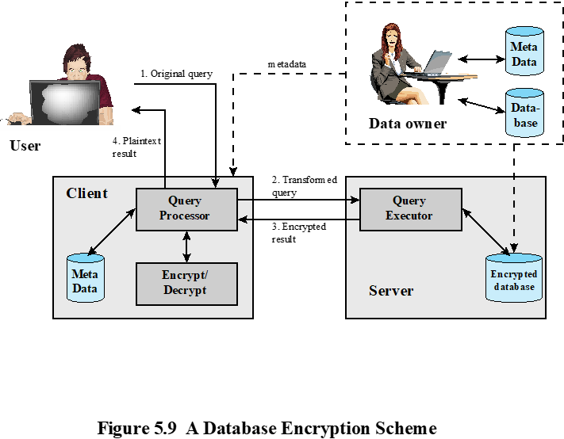
A Database Encryption Scheme
Data owner: organization that produces data to be made available for controlled release
User: human entity that presents queries to the system
Client: frontend that transforms user queries into queries on the encrypted data stored on the server
Server: an organization that receives the encrypted data from a data owner and makes them available for distribution to clients
Notes:
A straightforward solution to the security problem in this context is to encrypt
the entire database and not provide the encryption/decryption keys to the service
provider. This solution by itself is inflexible. The user has little ability to access
individual data items based on searches or indexing on key parameters, but rather
would have to download entire tables from the database, decrypt the tables, and
work with the results. To provide more flexibility, it must be possible to work with
the database in its encrypted form.
An example of such an approach, depicted in Figure 5.9 , is reported in
[DAMI05] and [DAMI03]. A similar approach is described in [HACI02]. Four
entities are involved:
• Data owner: An organization that produces data to be made available for
controlled release, either within the organization or to external users.
• User: Human entity that presents requests (queries) to the system. The user
could be an employee of the organization who is granted access to the database
via the server, or a user external to the organization who, after authentication,
is granted access.
Client: Frontend that transforms user queries into queries on the encrypted
data stored on the server.
• Server: An organization that receives the encrypted data from a data owner
and makes them available for distribution to clients. The server could in
fact be owned by the data owner but, more typically, is a facility owned and
maintained by an external provider.

Slide 35
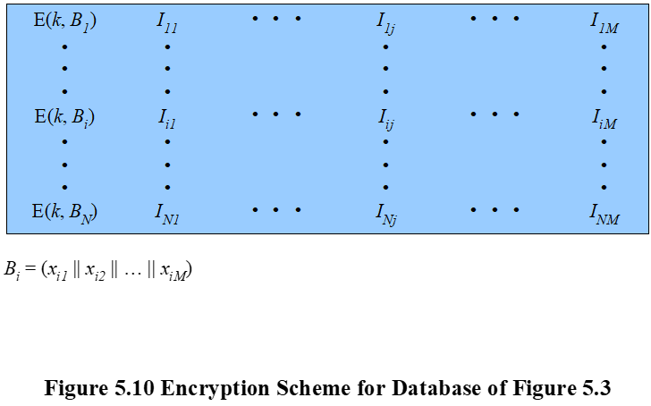
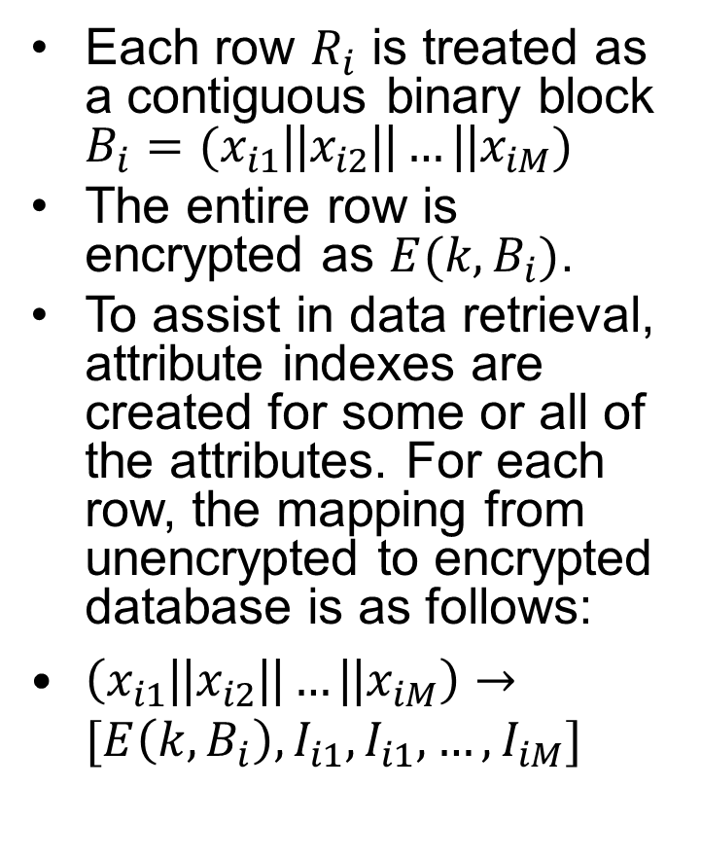
Each row $R_{i}$ is treated as a contiguous binary block $B_{i}=(x_{i1}\text{||}x_{i2}\text{||}…\text{||}x_{iM})$
The entire row is encrypted as $E(k,B_{i})$.
To assist in data retrieval, attribute indexes are created for some or all of the attributes. For each row, the mapping from unencrypted to encrypted database is as follows:
$\left(x_{i1}\text{||}x_{i2}\text{||}…\text{||}x_{iM}\right)→[E\left(k,B_{i}\right), I_{i1},I_{i1},…,I_{iM}]$
Notes:
Each record (row)
of a table in the database is encrypted as a block. Referring to the abstract model
of a relational database in Figure 5.3, each row R_{i} is treated as a contiguous block
B_{i} = (x_{i1} || x_{i2} ||…|| x_{iM} ). Thus, each attribute value in R_{i} , regardless of whether it
is text or numeric, is treated as a sequence of bits, and all of the attribute values
for that row are concatenated together to form a single binary block. The entire
row is encrypted, expressed as E (k, B_{i} ) = E (k, (x_{i1} || x_{i2} ||…|| x_{iM} )). To assist in data
retrieval, attribute indexes are associated with each table. For some or all of the
attributes an index value is created. For each row R_{i} of the unencrypted database, the
mapping is as follows (see Figure 5.10):
(x_{i1}, x_{i2}, … , x_{iM} ) →[E (k, B_{i}), I_{i1}, I_{i2} , … , I_{iM} ]
For each row in the original database, there is one row in the encrypted database.
The index values are provided to assist in data retrieval. We can proceed as
follows. For any attribute, the range of attribute values is divided into a set of non-overlapping
partitions that encompass all possible values, and an index value is
assigned to each partition.

Slide 36
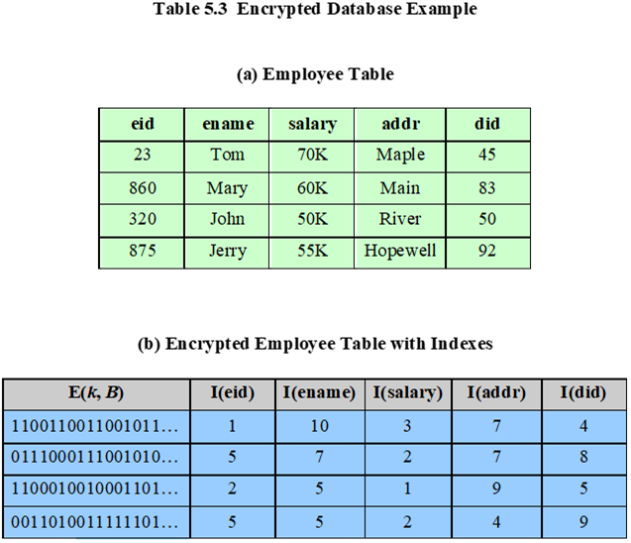
Notes:
Table 5.3 provides an example of this mapping. Suppose employee ID (eid )
values lie in the range [1, 1000]. We can divide these values into five partitions:
[1, 200], [201, 400], [401, 600], [601, 800], and [801, 1000]; then assign index values 1,
2, 3, 4, and 5, respectively. For a text field, we can derive an index from the first letter
of the attribute value. For the attribute ename , let us assign index 1 to values starting
with A or B, index 2 to values starting with C or D, and so on. Similar partitioning
schemes can be used for each of the attributes. Table 5.3b shows the resulting table.
The values in the first column represent the encrypted values for each row. The actual
values depend on the encryption algorithm and the encryption key. The remaining
columns show index values for the corresponding attribute values. The mapping functions
between attribute values and index values constitute metadata that are stored
at the client and data owner locations but not at the server.
This arrangement provides for more efficient data retrieval. Suppose, for
example, a user requests records for all employees with eid 6 < 300. The query processor
requests all records with I (eid ) = 2. These are returned by the server. The query
processor decrypts all rows returned, discards those that do not match the original
query, and returns the requested unencrypted data to the user.
The indexing scheme just described does provide a certain amount of information
to an attacker, namely a rough relative ordering of rows by a given attribute. To
obscure such information, the ordering of indexes can be randomized. For example,
the eid values could be partitioned by mapping [1, 200], [201, 400], [401, 600],
[601, 800], and [801, 1000] into 2, 3, 5, 1, and 4, respectively. Because the metadata are
not stored at the server, an attacker could not gain this information from the server.
Other features may be added to this scheme. To increase the efficiency of accessing
records by means of the primary key, the system could use the encrypted value of
the primary key attribute values, or a hash value. In either case, the row corresponding
to the primary key value could be retrieved individually. Different portions of the
database could be encrypted with different keys, so users would only have access to
that portion of the database for which they had the decryption key. This latter scheme
could be incorporated into a role-based access control system.

Slide 37
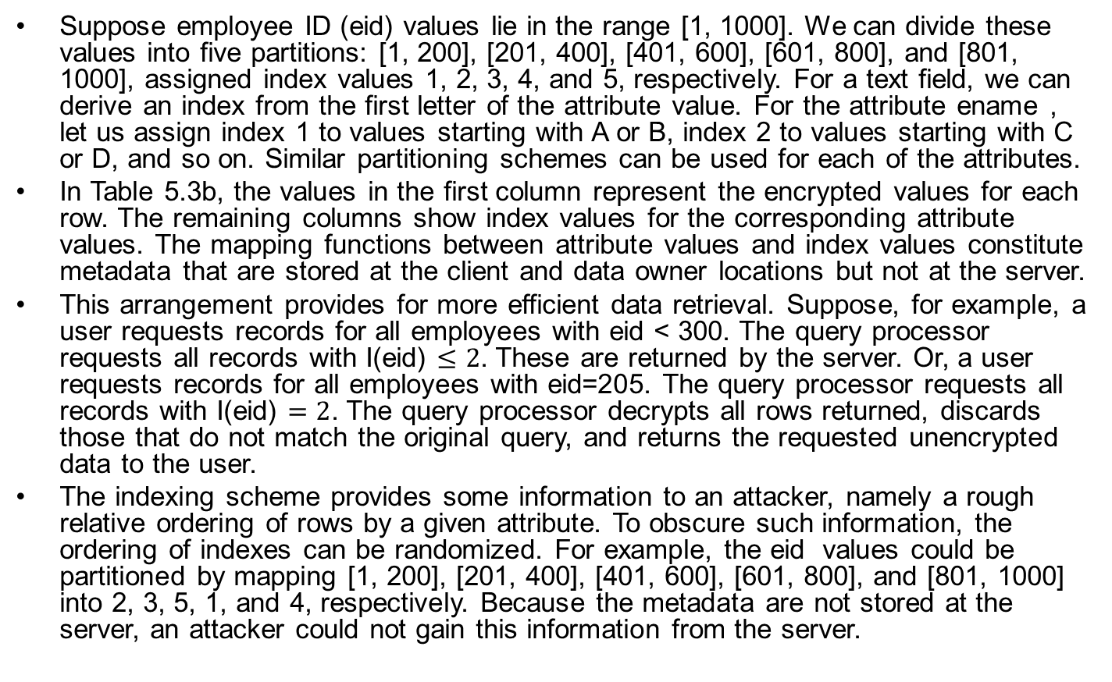
Table 5.3 Explanations
Suppose employee ID (eid) values lie in the range [1, 1000]. We can divide these values into five partitions: [1, 200], [201, 400], [401, 600], [601, 800], and [801, 1000], assigned index values 1, 2, 3, 4, and 5, respectively. For a text field, we can derive an index from the first letter of the attribute value. For the attribute ename , let us assign index 1 to values starting with A or B, index 2 to values starting with C or D, and so on. Similar partitioning schemes can be used for each of the attributes.
In Table 5.3b, the values in the first column represent the encrypted values for each row. The remaining columns show index values for the corresponding attribute values. The mapping functions between attribute values and index values constitute metadata that are stored at the client and data owner locations but not at the server.
This arrangement provides for more efficient data retrieval. Suppose, for example, a user requests records for all employees with eid < 300. The query processor requests all records with I(eid) $≤2$. These are returned by the server. Or, a user requests records for all employees with eid=205. The query processor requests all records with I(eid) $=2$. The query processor decrypts all rows returned, discards those that do not match the original query, and returns the requested unencrypted data to the user.
The indexing scheme provides some information to an attacker, namely a rough relative ordering of rows by a given attribute. To obscure such information, the ordering of indexes can be randomized. For example, the eid values could be partitioned by mapping [1, 200], [201, 400], [401, 600], [601, 800], and [801, 1000] into 2, 3, 5, 1, and 4, respectively. Because the metadata are not stored at the server, an attacker could not gain this information from the server.
Notes:
Other features may be added to this scheme. To increase the efficiency of accessing
records by means of the primary key, the system could use the encrypted value of
the primary key attribute values, or a hash value. In either case, the row corresponding
to the primary key value could be retrieved individually. Different portions of the
database could be encrypted with different keys, so users would only have access to
that portion of the database for which they had the decryption key. This latter scheme
could be incorporated into a role-based access control system.

